Slide 1
Data Analysis Journey
By: AbdEl-Rhman Asharf

Slide 2
Main Steps
Ask - Define the Problem.
Process - Cleaning and transform Data.
Analyze - Finding Patterns, Relationships, and Trends.
Share - Communicating Insights.

Slide 3
Ask
In this phase, I would define the problem and the goal of the task
The task is to clean, analyze, transform data, and build a dashboard using Excel, SQL Server, SSIS, and Power BI.
The data used in this task is a sales data set collected monthly about retail invoice data.

Slide 4
Process
In this phase, I cleaned and transformed the data using Excel, SQL Server and SSIS.
Excel: to clean the sales data using power query and add the lookups sheet for each ID.
SQL Server and SSIS: to create the stare schema and the ETL pipleline to populate the cleaned data into the database.

Slide 5
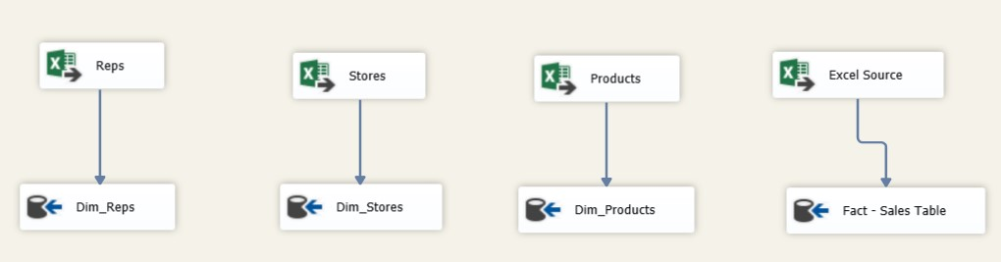
SSIS Pipelines

Slide 6
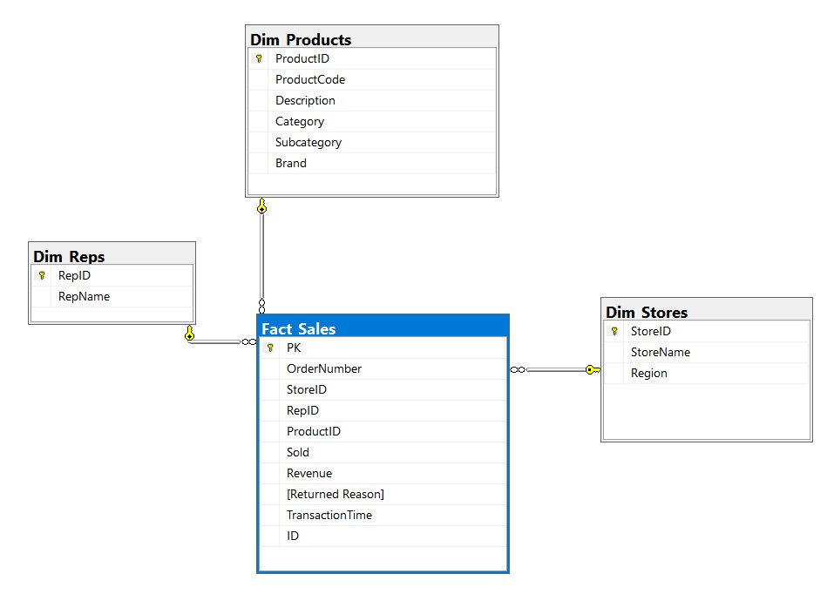
Star Schema

Slide 7
Share
In this phase, I would communicate the findings and recommendations to the stakeholders using Power BI.
Power BI: to connect to the data warehouse and create a descriptive dashboard.

Slide 8


Slide 9
Thank You

